Slide 1

I've been to the summer camp,
now what?
May 12, 2016
Mariana Carrasco-T.
Assistant Director of Michigan Institute for Computational Discovery & Engineering (MICDE)
mcteja@umich.edu
arc.umich.edu

Slide 2
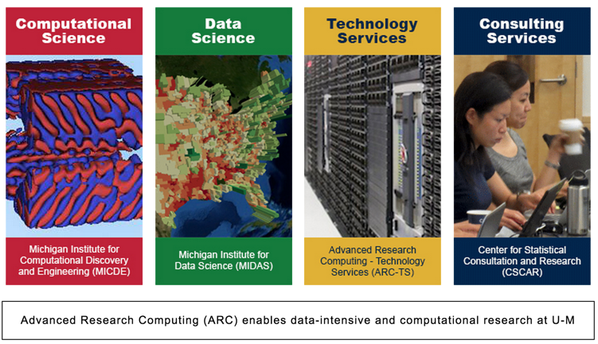
What is ARC?
Notes:
Established in 2008 (Research Cyberinfrastructure) to provide leading edge cyberinfrastructure services to the U-M academic community for competititve advantage
ARC encompasses two inst, blah, blah, ARC-TS and consulting services

Slide 3
Advanced Research Computing (ARC):
Provides Flux, the shared, campus-wide high-performance computing cluster through Advanced Research Computing - Technology Services (ARC-TS)
Provides or facilitates access to other research computing resources on and off the U-M campus, including running a free data science Hadoop cluster, through ARC-TS
Affiliates the Michigan Institute for Computational Discovery and Engineering (MICDE) and the Michigan Institute for Data Science (MIDAS) to support academic programmatic initiative and multi-disciplinary collaboration
Promotes training and support for users of computational research resources, through Consulting for Statistics, Computing, and Analytics Research (CSCAR), and a variety of other learning opportunities available to the U-M community.
Notes:
Housed administratively in UMOR (OVPR), line to the Provost,Cross-campus, inter-disciplinary, making research computing visible, making computing-enabled research visible

Slide 4
Is advanced research computing relevant to me?
NSF HPC+ Strategy high-level goal:
“Provide computational infrastructure to advance computational- and data-enabled science and engineering across all scientific and engineering disciplines”
ACI-1341698, Michael Norman, UCSD, “Gateways to Discovery: Cyberinfrastructure for the Long Tail of Science” (Comet system), 10/1/2013, 5 years, $12M
ACI-1341711, Daniel Stanzione, UT-Austin, “Wrangler: A Transformational Data Intensive Resource for the Open Science Community” (Wrangler system), 11/1/2013, 2 years, $6M

Slide 5
Funding for Big Data Core Technologies
In 2012 & 2013, NSF & NIH awarded 45 projects ranging from $250K/year for up to 3 years to $1M/year for up to 5 years
51% by number of projects went to “Data Collection, Management, Mining and Machine Learning”
An additional 10% went to “Social Networks”

Slide 6
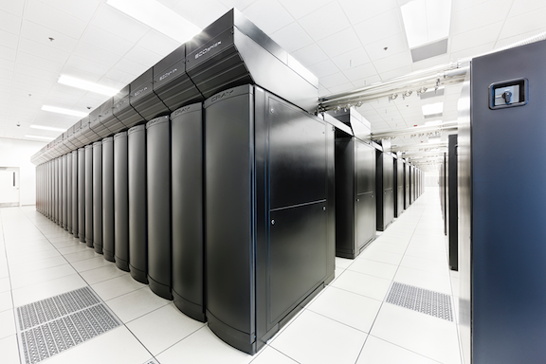
The sky’s the limit (currently Blue Waters is)...

Slide 7
Where can I find information about advanced research computing?
The ARC website: arc.umich.edu
ARC weekly email: to subscribe, see the footer of any page on the website.
Research Computing Symposia (Spring, Fall)
Research Computing Symposium poster sessions (prizes!)
ARCs director Twitter: @sbroudegeva (relevant retweets from various sources, no cats)
ARC’s Twitter: @ARCatUM

Slide 8
… and training?
HPC100, HPC101, etc. - every couple of months
http://cscar.research.umich.edu/hpc-workshops/
Flux open user meetings
ARC website + weekly email
ARC Twitter (advance notice for training!)
Online resources, for example:
Python - http://www.codecademy.com/
SQL - http://www.sqlcourse.com
http://software-carpentry.org/workshops/

Slide 9

The Scientific Computing Student Club was founded on Fall 2015 to develop a community across disciplines that fosters collaboration and peer support for scientific computing
Social happy hours, special seminars, visits to Flux facilities, kayaking trip, etc.
Visit http://micde.umich.edu/sc2/

Slide 10
More involved training and learning
XSEDE training, remote training, …...
Info about training events is always posted on the ARC website and sent out in the periodic email update
June 14 -17, the Scientific Computing Student Club is hosting and XSEDE summer boot camp that will culminate in a hybrid exercise contest.
MORE info http://micde.umich.edu/sc2/xsede-summer-boot-camp-hosted-by-sc2/

Slide 11
Graduate Data Science Certificate Program
Through the Michigan Institute for Data Science (MIDAS)
The Rackham-approved Data Science Certificate program aims to provide core experiences in:
(Modeling) Understanding of core Data Science principles, assumptions & applications;
(Technology) Data management, computation, information extraction & analytics;
(Practice) Hands-on experience with modeling tools and technology using real data.
For more information, http://midas.umich.edu/certificate/
Contact: Ivo D. Dinov (dinov@umich.edu)

Slide 12
Where can I find more compute power?
Flux - the on-campus shared computing cluster (provided by ARC; a for-fee service)
http://arc-ts.umich.edu/flux/
* Some schools and departments have also bought allocations for shared use
XSEDE - 16 supercomputers and high-end visualization and data analysis resources across the country (Provided by the NSF; free with a short proposal) www.xsede.org
Contact: Brock Palen,hpc-support@umich.edu

Slide 13
Where can I find people to help me?
ARC Liaisons: Charles Antonelli (cja@umich.edu) (LSAIT) for LSA; Todd Raeker (raeker@umich.edu) for Ross and other Central Campus units
XSEDE - Brock Palen (hpc-support@umich.edu)
UM3D lab - Advanced visualization
CSCAR - Statistics consulting (http://cscar.research.umich.edu/consulting)
Visualization Librarian - Justin Joque
Spatial and Numeric Data Librarians (assist in finding, manipulating and analyzing diverse types of data, GIS) (http://www.lib.umich.edu/clark-library/services/sand)

Slide 14
Besides social media, where else can I find data online?
HathiTrust - Millions of digitized library collections (Jeremy York, MLibrary)
http://www.hathitrust.org/
DPLA - Digital Public Library of America dp.la
EEBO-TCP - Early English Books 1475-1700 (Rebecca Welzenbach, MLibrary) http://www.textcreationpartnership.org/tcp-eebo/

Slide 15
Advanced Research Computing
Questions?
sgeva@umich.edu
mcteja@umich.edu
arc.umich.edu

